Slide 1










Inclusive primary physical education and its implementation
Learning, teaching and training activity
Brixen 6th - 10th June 2022
Trnava University

Slide 2




Introduction
Short description of the study programmes at Trnava University:
Bachelor study 3 years – 180 ECTS
Preschool and elementary education
PE course – 10 ECTS – 3 hours lecture/2 hours seminar/2 hours exercise gym/1 hour practice in kindergarten
Master study 2 years – 120 ECTS
Teaching in Primary Education
PE course – 6 ECTS – 2 hours lecture/1 hour exercice gym/1 hour practice in primary school

Slide 3
Introduction
Short description of the module:
Title: Physical and Health Education
The full module is focused on a complex understanding of quality physical education in primary schools and its implementation.
It is taught in the 1st semester of the Master study
Theory 2 hours/week
Practice in gym 1hour/week
Practice in schools 1hour/week
Short description of the micromodule:
Title: Inclusive primary physical education and its implementation
In this micromodule the students will especially get information on teaching methods and strategies in PE with the focus on inclusive physical education. The practical activities will help the student with the demonstration of the inclusive PE practice.
Theory classroom (1 hour) + practical in sports hall (1 hour)

Slide 4
Introduction
This micromodule is based on a previous Erasmus+ project called „Disentangling Inclusion in Primary Physical Education (DIPPE)“
The aim of the DIPPE project was to create an online platform for primary school teachers (generalist and specialist) and primary student teachers to support inclusive practice within primary physical education
The practical activities were also inspired by the Pestalozzi Programme „Physical education and sports for democracy and human rights“ and Slovak website for PE teachers „www.telocvikari.sk“

Slide 5



Understanding and planning for inclusion
What does inclusion mean to you?
‘Ask Us, Hear Us, Include Us!’
Click here for the film
Notes:
Just play until 2:39
This film was developed in Scotland by the Young Inclusion Ambassadors. Keen to share their views on what works in inclusion, the Young Ambassadors decided to create a film which could allow their views, and their voices to be heard and could help staff know how to support young people with additional support needs. While those that have contributed to the production of the media clip are adolescents the key issues raised are applicable regardless of age, ability or disability.
Watch the beginning of the film and then engage in discussion using the next slide.

Slide 6
Understanding and planning for inclusion
Reflect on the themes of inclusion identified by the Young Ambassadors and discuss how they relate to your thinking:
The need to be respected
Treated equally
Recognising Strengths
Friendship and belonging
Positive attitudes
Awareness of Additional Support Needs

Slide 7
Understanding and planning for inclusion
A sense of belonging, which includes feeling respected, valued for who you are, feeling a level of supportive energy and commitment from others. This means that diversity is valued and promoted within learning communities.
Inclusion does not ensure inclusiveness, there is a need to recognise and respond to barriers that exclude which means that inclusion is an ongoing process and attitude which goes beyond simple integration.

Slide 8
Understanding and planning for inclusion
Inclusive Education: A human right
Inclusive education for all learners is a right that has been increasingly recognised internationally in recent decades.
Legislation supporting inclusive education:
1948/1989 - United Nations Convention on the Rights of the Child
1978 /2015- The International Charter for Physical Education, Physical Activity and Sport (Sport Charter, UNESCO)
2006 - United Nations Convention on the Rights of Persons with Disabilities

Slide 9
Understanding and planning for inclusion
Inclusive Pedagogy - Actions
Person comes first.
Communication is key.
Privilege the importance of participation.
Make a range of differentiated options available, encouraging pupil choice.
Consider experience, and needs of all learners.
Pupil voice.

Slide 10

DIVERSITY
Individual differences should be expected, understood and valued.
Engage young people in dialogue about difference, diversity, tolerance, trust, respect and inclusion.
Know and understand learners and their needs.
Continuous process responding to and learning from diversity.

Slide 11
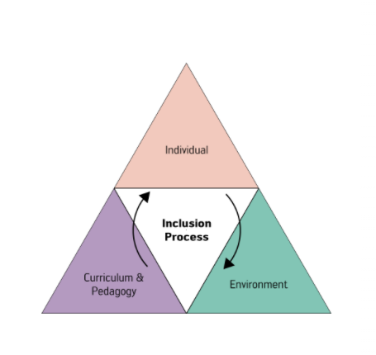
Components of inclusive practice
This means, that as a teacher you need to consider individual needs and interests, the environment you are teaching in and what and how you are teaching – curriculum and pedagogy

Slide 12
Examples of scenarios
(for more information please visit the website: www.dippe.lu)
Chronic conditions
Gross and fine motor skills
Physical capabilities
Sensory
Social and emotional
Verbal and non-verbal communication
Attention and concentration

Slide 13
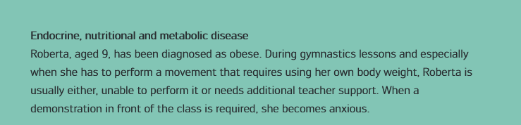
Chronic conditions
Scenario 1- Roberta

Slide 14
Including Roberta:
(a) Can you identify what Roberta CAN do from reading the scenario presented?
(b) Let’s talk about what challenges arise for Roberta in her everyday life in school?
(c) Now let’s examine what challenges arise for Roberta in her PE lessons?
(a) Can you identify what Roberta CAN do from reading the scenario presented?
(b) Let’s talk about what challenges arise for Roberta in her everyday life in school?
(c) Now let’s examine what challenges arise for Roberta in her PE lessons?

Slide 15
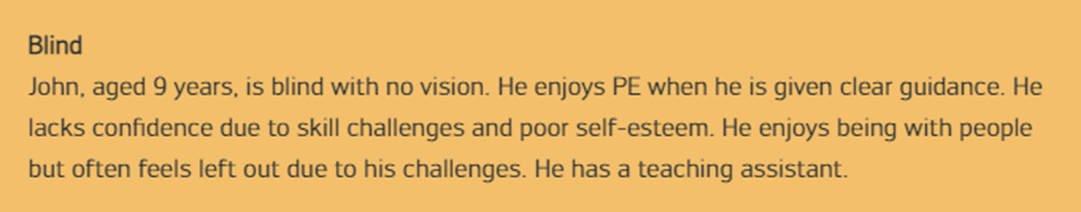
Sensory conditions
Including John:

Slide 16
Including John:
(a) Can you identify what John CAN do from reading the scenario presented?
(b) Let’s talk about what challenges arise for John in his everyday life in school?
(c) Now let’s examine what challenges arise for John in his PE lessons?

Slide 17
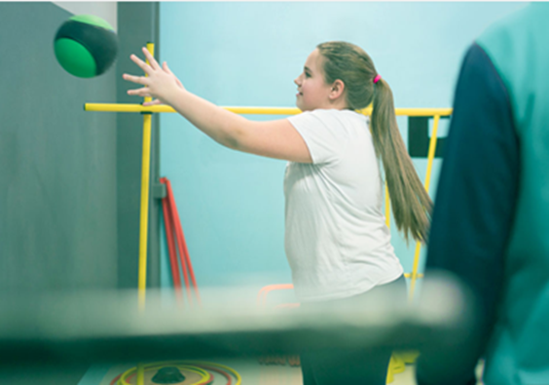

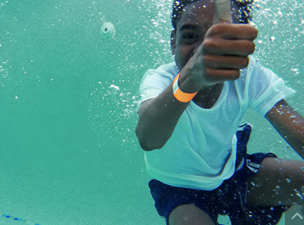
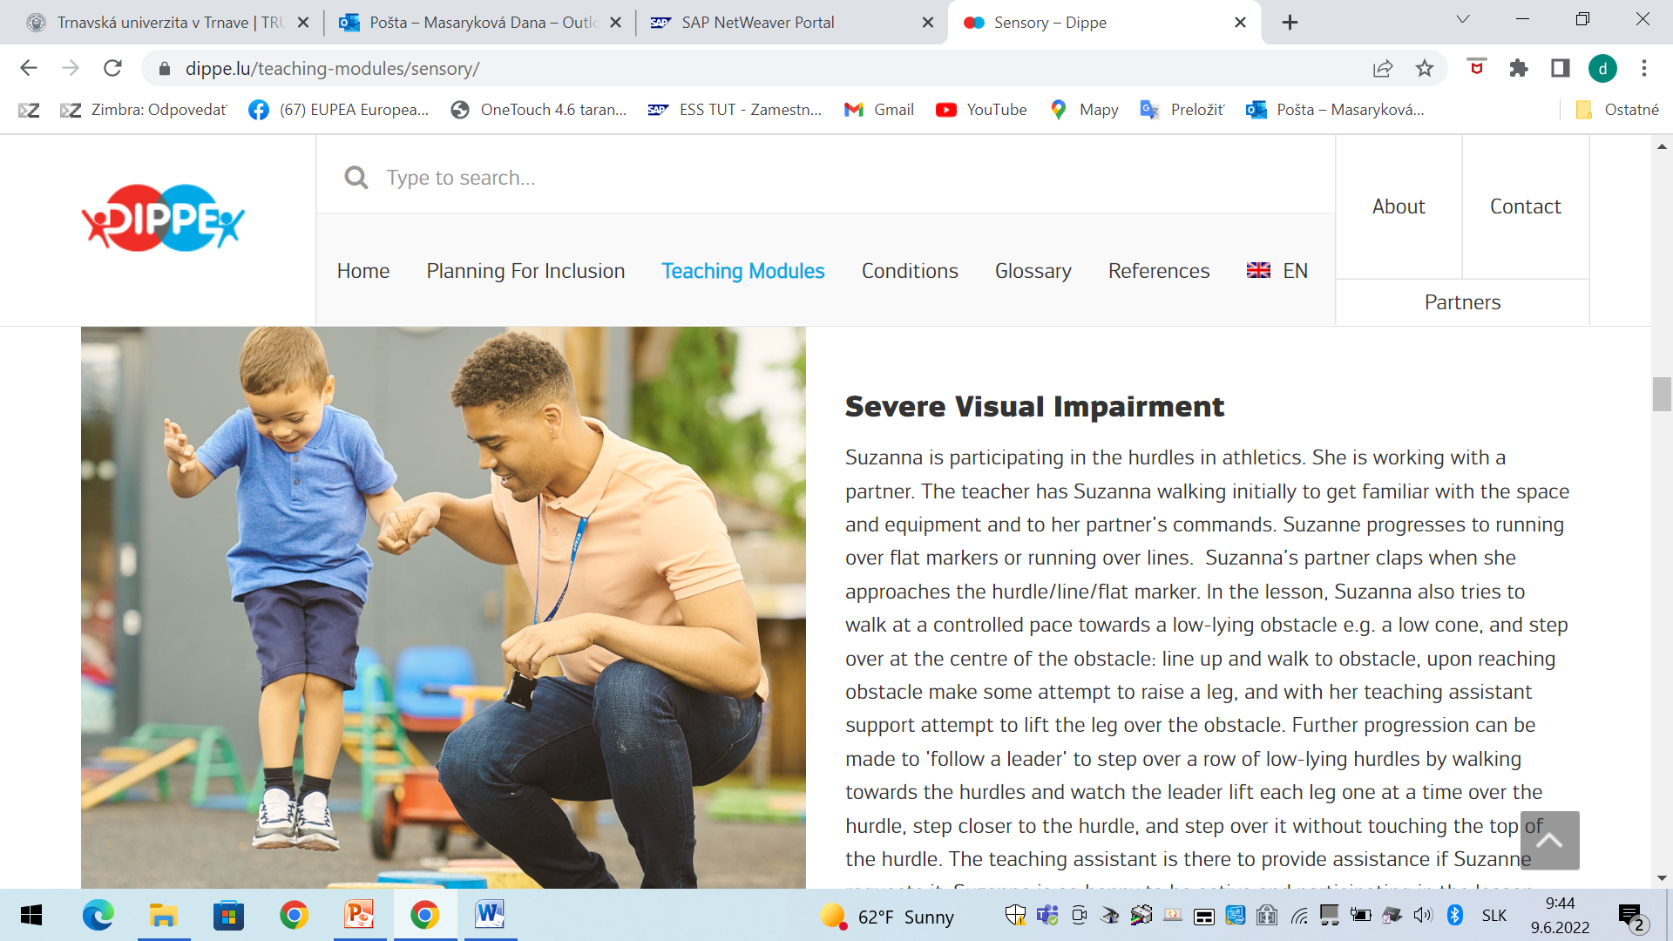
Let’s go to the gym to practice!

Slide 18
Resources
Basic Motor Competences in Europe (2019). Retrieved from: http://mobak.info/en/mobak/
Disentangling Inclusion in Primary Physical Education (2021). Retrieved from: https://www.dippe.lu/
Florian, L. (2015). Conceptualising inclusive pedagogy: The inclusive pedagogical approach in action. In J. M., Deppeler, T., Loreman, R., Smith & L., Florian (eds), Inclusive Pedagogy Across the Curriculum. Vol. 7. (pp. 11-24). Bingley: Emerald Group Publishing Limited.
Lieberman, L., Lytle, R., & Clarcq, J. A. (2008). Getting it Right from the Start. Employing the Universal Design for Learning into your Curriculum. Journal of Physical Education, Recreation and Dance, 79(2), 32-39.
Liberman L., & Greiner M, (2019). Infusing universal design for learning into physical education professional preparation programmes. Journal of Physical Education, Recreation and Dance, 90:6, 3-5.
Pestallozzi Programme: Physical education and sports for democracy and human rights. Retrieved from: https://pestalozziprogrammelibrary.wordpress.com/category/primary-menu-content-categories/pestalozzi-programme/training-units/physical-education-and-sport-for-democracy-and-human-rights/
United Nations (1989). Convention on the Rights of the Child. Treaty Series, 1577, 3.
United Nations Educational, Scientific and Cultural Organisation (UNESCO) (2005). Guidelines for inclusion: ensuring access to education for all. Retrieved from https://unesdoc.unesco.org/ark:/48223/pf0000140224
United Nations (2006). Convention of the Rights of Persons with Disabilities: resolution / adopted by the General Assembly, 24 January 2007, A/RES/61/106
United Nations Educational, Scientific and Cultural Organisation (UNESCO) (2015). International Charter of Physical Education, Physical Activity and Sport. UNESCO.
United Nations Educational, Scientific and Cultural Organisation (UNESCO) (2015). Quality Physical Education (QPE). Guidelines for policy-makers [online]. Retrieved from: https://unesdoc.unesco.org/ark:/48223/pf0000231101
UNESCO Chair, IT Tralee (2018), Inclusivizing PEPAS Model, iPEPAS Training and Education Resources.
UNESCO Chair, IT Tralee (2015). The Pathway to Diversity [online]. Retrieved from: http://unescoittralee.com/about-us/pathway-to-diversity/
https://www.telocvikari.sk/

