Slide 1
Motor Development, Learning and Implications to Physical Education Teaching
Nuno Ferro, Carolina Santos, Sara Martins e Diogo Ribeiro
Faculdade de Motricidade Humana, Universidade de Lisboa
PRIME PETE LTT#4+#5
Lisboa, September 12th-16th 2022

Slide 2
Learning Outcomes
Identify the particularities of the Motor Development and Learning of children in primary school and their implications for the Teaching-Learning of Physical Education
Identify the rules for the PE syllabus construction and implementation
Identify the main principles to plan and evaluate of the motor learning in Primary PE, by ensuring the differentiation of teaching according to the training needs of children

Slide 3
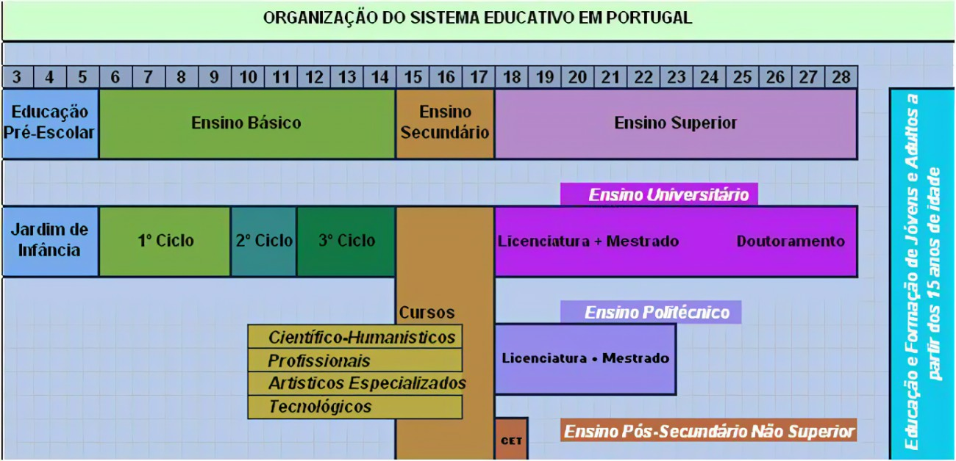
PE Contextualization

Slide 4
PE Contextualization
1st Grade
2nd Grade
3rd Grade
4th Grade
1st Cycle
6 till 10 years old
Portuguese
English (3rd & 4th grade)
Mathematics
Physical Education
Study of the environment
Sciences, History, …
Artistic Education

Slide 5
PE Contextualization
Portuguese Syllabus Content for Primary School
Contents of PE for 1st & 2nd Grade
Contents of PE for 3rd & 4th Grade
Skills & Manipulations
Rythmic & Expression
Rythmic & Expression
Gymnastics
Movement & Balance
Nature Tracks
Nature Tracks
Games
Games
Swimming
Skating
Swimming
Prime PETE LTT #2 + 3, Brixen, June 6th-10th 2022

Slide 6
PE Contextualization
PE Curricular System: compulsory PE from grade 1 to 12
Main principles: eclecticism, inclusiveness, multilateral education
Class teacher is the responsible for all subjects at primary school, including PE, autonomously or in collaboration with a specialist teacher (profiting from local schools networking)
Extra-curricular Physical Activity lead by specialist teachers
Great lack of PE in primary schools is being recovered
Prime PETE LTT #2 + 3, Brixen, June 6th-10th 2022
Notes:
Portuguese PE Curricular System: compulsory PE from grade 1 to 12 vertically articulated
Primary includes grades 1 to 4 (5/6 y to 8/9 years old)
Main principles: eclecticism, inclusiveness, multilateral education
Class teacher is the responsible for all subjects at primary school, including PE, autonomously or in collaboration with a specialist teacher (profiting from local schools networking)
Schools are offering extra-curricular Physical Activity lead by specialist teachers
There is a great lack of PE in primary schools, which is becaming to be solved since the implementation of national tests at grade 2

Slide 7
PE Contextualization
PE teaching problems identified by primary non-specialist teachers
“Absence of adequate resources (spaces and materials)”
"Impossibility of teaching/demonstrating for not knowing how to do it"
“Existence of “dangerous skills and situations””
"Lack of creativity or knowledge to invent motivating exercises or classes"
"Lack of pedagogical knowledge on specific teaching skills"
"Difficulty in maintaining order and discipline in class, avoiding disorganization"
“Difficulty in controlling the most "sassy"/"active" students”
(Diniz et al., 2001)
Prime PETE LTT #2 + 3, Brixen, June 6th-10th 2022

Slide 9
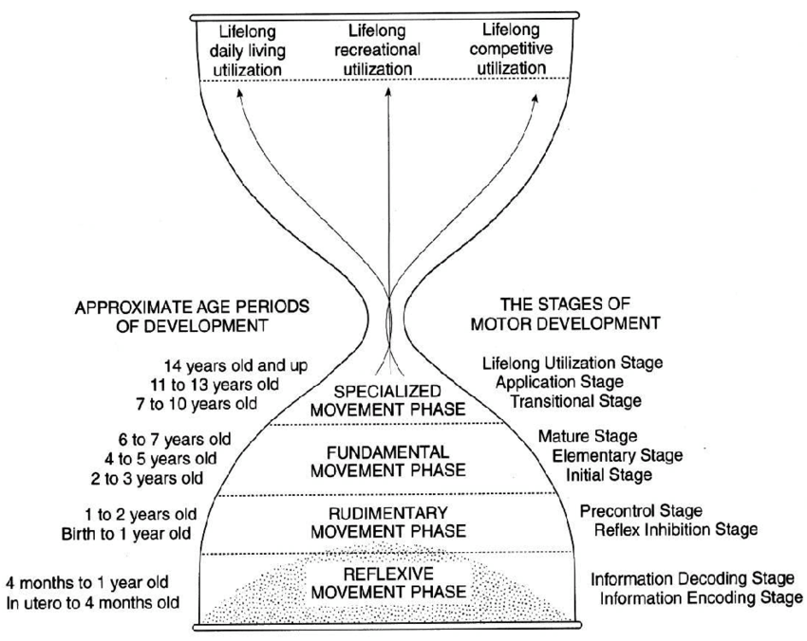

Slide 10
Practice & Learning
Motor Development
Respect
Stimulus

Slide 11
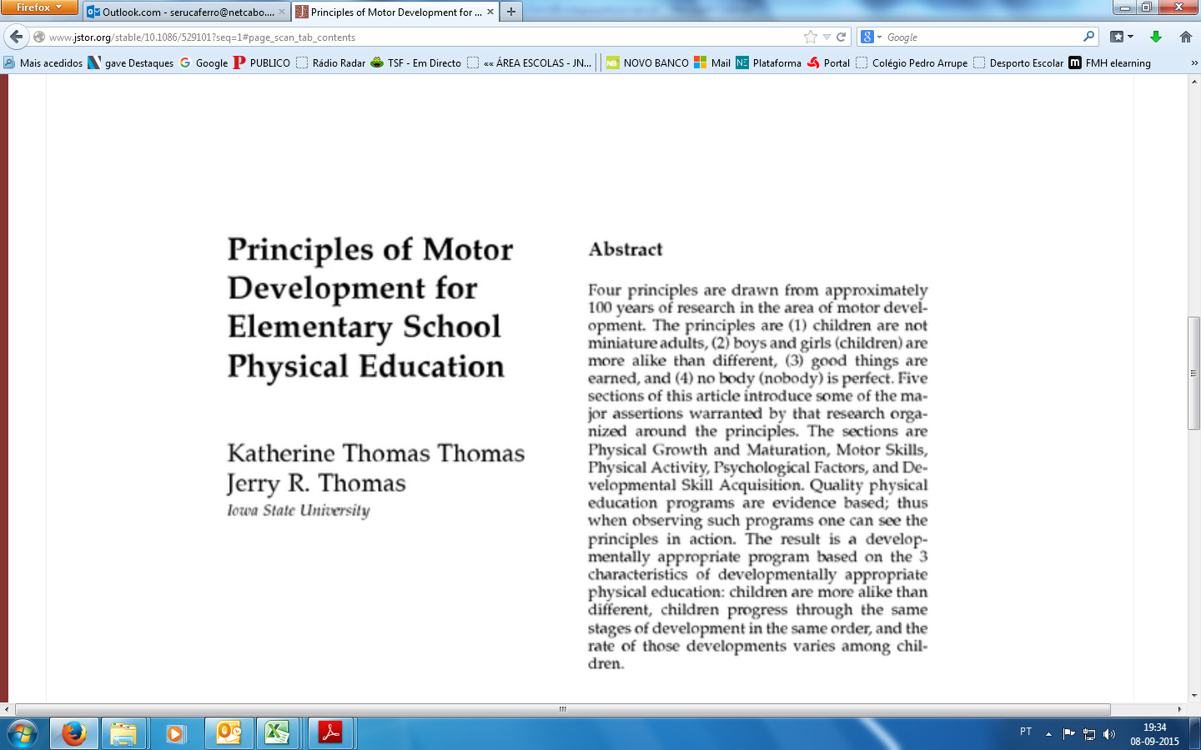

Slide 14
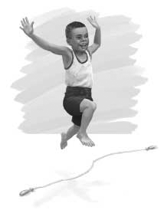
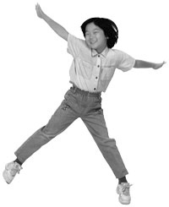
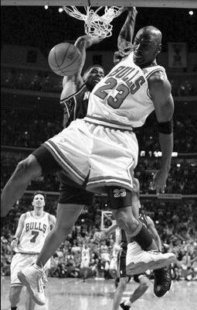
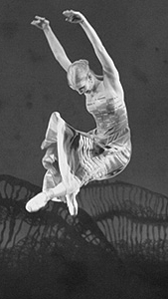
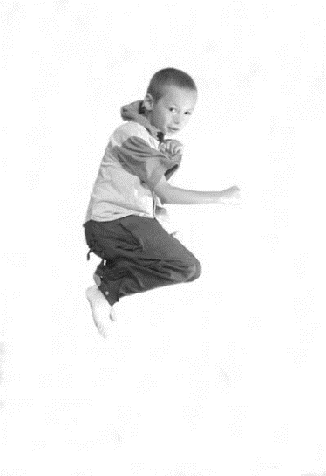
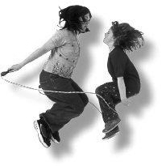
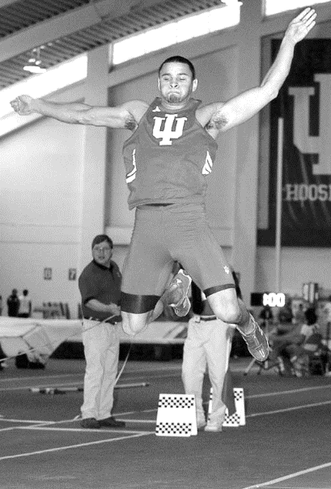
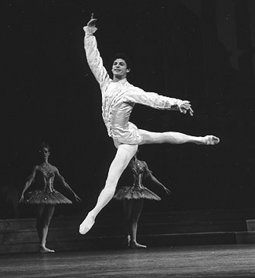
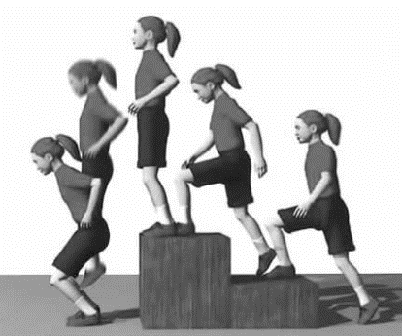

Slide 15
Specific
Performance
Complex
Selection
Combination
Descovery
General
Exploration
Simple

Slide 16
Pedagogical Environment
CLASS
Inclusive
Time to practice the activity with quantity and quality
Meaningful
Enjoyable
Promotion of respect
Promote cooperation and mutual help
Promotion of Autonomy
Promova a Autonomia
Seek success
Ensure security
Develop responsibility
Foster the Critical Spirit
Allow creativity
Fomente o Espírito Crítico

